Slide 1
Data preprocessing
Francesco Pugliese, PhD
frpuglie@istat.it

Slide 2
Types of data
Having a good understanding of the different data types, also called measurement scales, is a crucial prerequisite for doing Exploratory Data Analysis (EDA), since you can use certain statistical measurements only for specific data types.
You also need to know which data type you are dealing with to choose the right visualization method.
Think of data types as a way to categorize different types of variables.
Taking a broader perspective, data is classified into numerical and categorical data.
Numerical: As the name suggests, this is numeric data that is quantifiable. Numerical data is further divided into discrete and continuous
Categorical: The data is a string or non-numeric data that is qualitative in nature. Categorical data is further divided into ordered and nominal

Slide 3
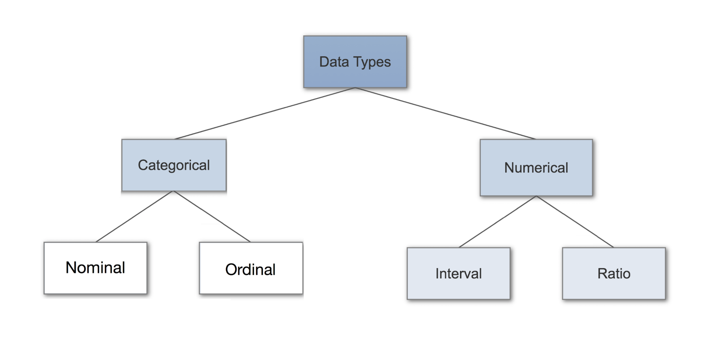
Types of data

Slide 4
Discrete data (Numerical)
To explain in simple terms, any numerical data that is countable.
Discrete data can only take certain values (such as 1, 2, 3, 4, etc).
Values are distinct and separate
can’t be measured but it can be counted
Example: the number of people in a family or the number of students in a class.
basically represents information that can be categorized into a classification

Slide 5
Continuous data (Numerical)
Any numerical data that is measurable is called continuous.
Example: the height of a person or the time taken to reach a destination.
Continuous data can take virtually any value (for example, 1.25, 3.8888, and 77.1276).
You can summarise your data using percentiles, median, interquartile range, mean, mode, standard deviation, and range.
Visualisation Methods: To visualise continuous data, you can use a histogram or a box-plot. With a histogram, you can check the central tendency, variability, modality, and kurtosis of a distribution. Note that a histogram can’t show you if you have any outliers. This is why we also use box-plots.

Slide 6
Nominal data (Categorical)
Any categorical data that has no order.
Example: gender, country etc..,
In Data Science, you can use one hot encoding, to transform nominal data into a numeric feature.
When you are dealing with nominal data, you collect information through:
Frequencies: The Frequency is the rate at which something occurs over a period of time or within a dataset.
Proportion: You can easily calculate the proportion by dividing the frequency by the total number of events. (e.g how often something happened divided by how often it could happen)
Percentage.
Visualisation Methods: To visualise nominal data you can use a pie chart or a bar chart.

Slide 7
Ordinal data (Categorical)
Any categorical data that has some order associated with it.
Example: movie ratings (excellent, good, bad, worst) and feedback (happy, not bad, bad).
You can think of ordered data as being something you could mark on a scale.
Observe that the differences between the values is not really known.
Due to this reason they are usually used to measure non-numeric features like happiness, customer satisfaction and so on.
you can summarise your ordinal data with frequencies, proportions, percentages. And you can visualise it with pie and bar charts. Additionally, you can use percentiles, median, mode and the interquartile range to summarise your data.
you can use one label encoding, to transform ordinal data into a numeric feature.

Slide 8
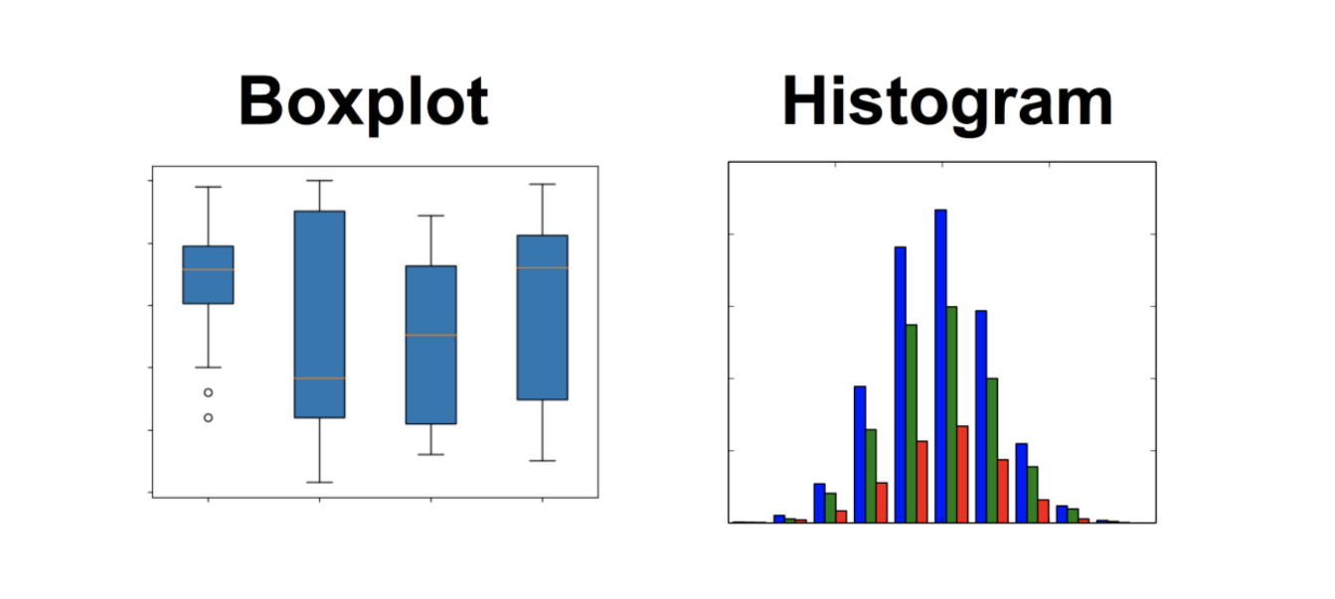
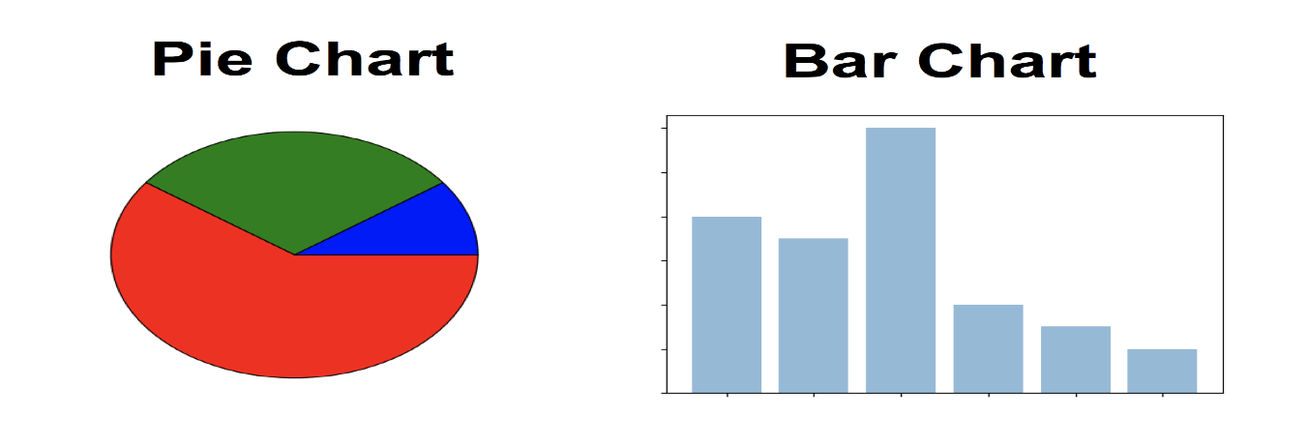
Data visualization types

Slide 9
Why Data preprocessing ?
Real-world data is often incomplete, inconsistent, and lacking in certain behaviors or trends, and is likely to contain many errors. i.e
Incomplete: lacking attribute values, lacking certain attributes of interest, or containing only aggregate data
Noisy: containing errors or outliers
Inconsistent: containing discrepancies in codes or names
Data preprocessing is a proven method of resolving such issues.
Data preprocessing, a technique that focuses more on Data cleaning, Data integration, Data transformation, Data dimensionality reduction, Data discretization.

Slide 10
Data Wrangling
When we perform data wrangling, we are taking our input data from its original state to a format where we can perform meaningful analysis on it.
Data manipulation is another way to refer to this process.
There is no set list or order of operations; the only goal is that the data post-wrangling is more useful to us than when we started.
There are three common tasks involved in the data wrangling process:
Data cleaning
Data transformation
Data enrichment
Let us see what each of these 3 tasks involve

Slide 11
Data cleaning
An initial round of data cleaning on our data frame will often give us the bare minimum we need to start exploring our data.
Some essential data cleaning tasks to master include the following:
Renaming
Sorting and reordering
Data type conversions
Deduplicating data
Addressing missing or invalid data
Filtering to the desired subset of data
Data cleaning is the best starting point for data wrangling since having the data stored as the correct data types and easy-to-reference names will open up many avenues for exploration and wrangling opportunities, such as summary statistics, sorting, and filtering.

Slide 12
Data transformation
Frequently, we will reach the data transformation stage after some initial data cleaning, but it is entirely possible that our dataset is unusable in its current shape, and we must restructure it before attempting to do any data cleaning.
We mainly focus on changing our data’s structure to facilitate our downstream analyses; this usually involves changing which data goes along the rows and which goes down the columns.
Most data we will find is either in a wide format or a long format; each of these formats has its merits, and it’s important to know which one we will need for our analysis.
Often, people will record and present data in the wide format, but there are certain visualizations that require the data to be in the long format.
The wide format is preferred for analysis and database design, while the long format is considered poor design because each column should be its own data type and have a singular meaning. When building an API, the long format may be chosen if flexibility is required.

Slide 13
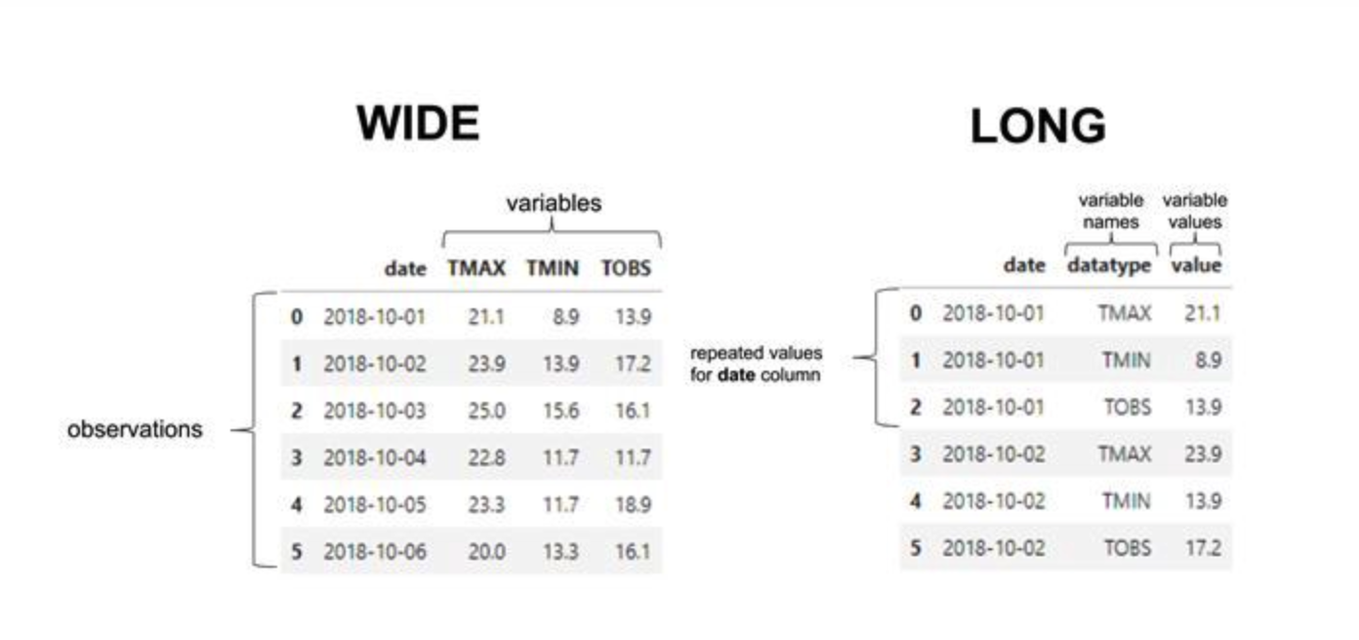
Wide vs Long format

Slide 14
Data enrichment
When we’re looking to enrich the data, we can either merge new data with the original data (by appending new rows or columns) or use the original data to create new data.
The following are ways to enhance our data using the original data:
Adding new columns: Using functions on the data from existing columns to create new values
Binning: Turning continuous data or discrete data with many distinct values into range buckets, which makes the column discrete while letting us control the number of possible values in the column
Aggregating: Rolling up the data and summarizing it
Resampling: Aggregating time series data at specific intervals

Slide 15

Data Normalization
Also referred to as Column Normalization. Data Normalization usually means to scale a variable to have a value between 0 and 1, and we can achieve that by using the following formula:
Example: Let us consider a list of numberic values, x[] = [3.5, 3.0, 3.2, 3.1, 3.6, 3.7, 3.4, 3.4, 2.9, 2.7]
and apply data normalization using above equation as follows,
x max = max(numAry) = 3.7
x min = min(numAry) = 2.7
x[] new = [0.7, 0.2, 0.5, 0.3, 0.8, 1.0, 0.6, 0.6, 0.1, 0.0]

Slide 16

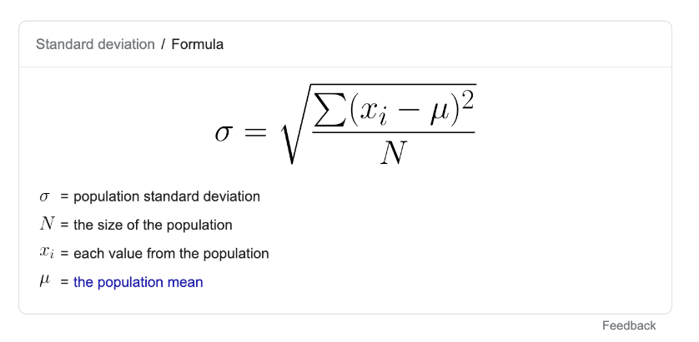
Data Standardization
Standardization transforms data to have a mean of zero and a standard deviation of 1. Data points can be standardized with the following formula:
Where S is standard deviation
Example: Let us consider a list of numberic values, x[] = [3.5, 3.0, 3.2, 3.1, 3.6, 3.7, 3.4, 3.4, 2.9, 2.7]
and apply data standardization using above equation as follows,
x̄ = mean(x[]) = 3.25
S = standard deviation(x[]) = 0.32403703492039304
x[] new = [0.77, -0.77, -0.15, -0.46, 1.08, 1.38, 0.46, 0.46, -1.0, -1.6]

Slide 17
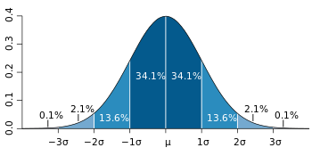
Data Normalization
What we meant by standard deviation by 1 is all the points will lie between -1σ and 1σ(as shown below).
As 68% of the values lie within one standard deviation of the mean. Here we can say that one standard deviation is between -1.5 and 1.5.
Column Standardization is also called as Mean Centering.
Sometimes it’s also known as z-score.

Slide 18
Encoding categorical data
There are some algorithms that can work well with categorical data, such as decision trees. But most machine learning algorithms cannot operate directly with categorical data.
These algorithms require the input and output both to be in numerical form. If the output to be predicted is categorical, then after prediction we convert them back to categorical data from numerical data.
There are three simple methods of encoding categorical data:
Replacing
Label Encoding
One-Hot Encoding

Slide 19
Encoding categorical data
Replacing:
This is a technique in which we replace the categorical data with a number.
This is a simple manual replacement and does not involve much logical processing
Label encoding:
This is a technique in which we replace each value in a categorical column with numbers from 0 to N-1. For example, say we've got a list of employee names in a column. After performing label encoding, each employee name will be assigned a numeric label.
Label encoding is the best method to use for ordinal data.
The scikit-learn library provides LabelEncoder(), which helps with label encoding.
One hot encoding:
Here, the label-encoded data is further divided into n number of columns. Here, n denotes the total number of unique labels generated while performing label encoding.
For example, say that three new labels are generated through label encoding. Then, while performing one-hot encoding, the columns will be divided into three parts.

Slide 20
Data Integration
Data Integration (or Information Integration) is the problem of finding and combining data from different sources.
Process of combining data from different sources into a single, unified view.
Integration begins with the ingestion process, and includes steps such as cleansing, ETL mapping, and transformation.
Data integration ultimately enables analytics tools to produce effective, actionable business intelligence.
Abstracting out the differences between individual systems, a typical view-based data integration system (VDIS) conforms to the architecture shown in the next slide.

Slide 21
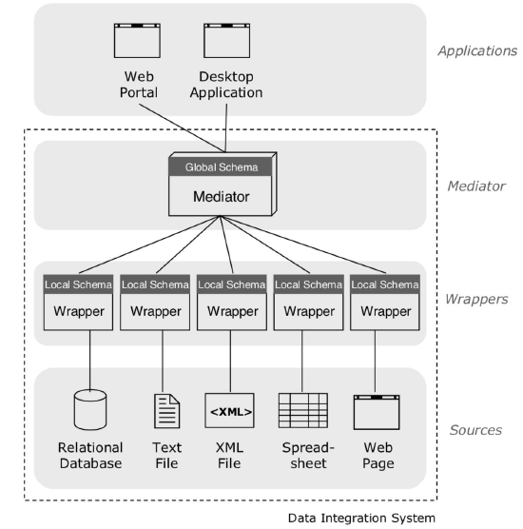
View based data integration system (VDIS)

Slide 22
View based data integration system (VDIS)
Sources: store the data in a variety of formats (relational databases, text files etc.).
Wrappers: solve the heterogeneity in the formats by transforming each source’s data model to a common data model used by the integration system.
The wrapped data sources are usually referred to as local or source databases, the structure of which is described by corresponding local/source schemas. This is in contrast to the unified view exported by the mediator, also called global/target database.
Finally, mappings expressed in a certain mapping language (depicted as lines between the wrapped sources and the mediator) specify the relationship between the wrapped data sources (i.e. the local schemas) and the unified view exported by the mediator (global schema).

Slide 23
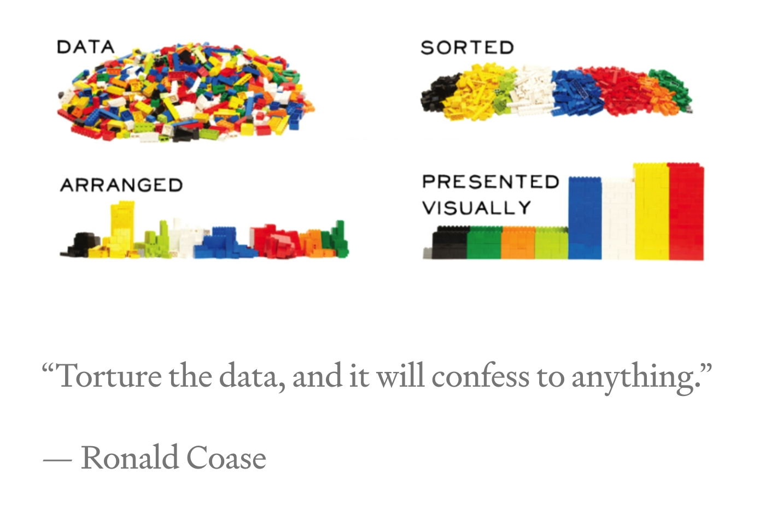
Exploratory data analysis(EDA)

Slide 24
Exploratory data analysis(EDA)
Exploratory Data Analysis (EDA) is the process of visualizing and analyzing data to extract insights from it. In other words, EDA is the process of summarizing important characteristics of data in order to gain better understanding of the dataset.
Methods for EDA:
Descriptive Statistics
Grouping of Data
Handling missing values in dataset
ANOVA: Analysis of variance Correlation
Lets understand each of the above methods

Slide 25
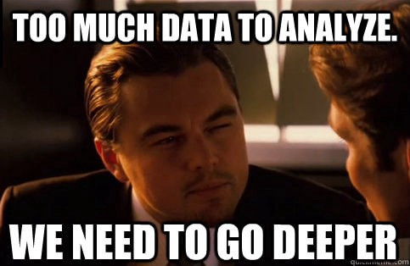
Exploratory data analysis(EDA)

Slide 26
Method 1: Descriptive statistics
Descriptive statistics analysis helps to describe the basic features of dataset and obtain a brief summary of the data.
The describe() method in Pandas library helps us to have a brief summary of the dataset. It automatically calculates basic statistics for all numerical variables excluding values.
But, what if we have categorical data? How can we get a summary of categorical data? The value_counts() method will be useful in this case.
To analyse the numerical data we can make use of different plots such as,
Box plot
Scatter plots
Histograms

Slide 27
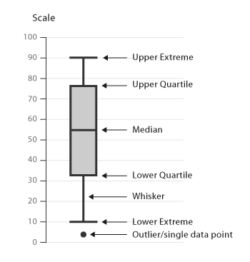
Plots for Descriptive statistics
Box-plot:
Box plot shows us the median of the data, which represents where the middle data point is.
The upper and lower quartiles represent the 75 and 25 percentile of the data respectively.
The upper and lower extremes shows us the extreme ends of the distribution of our data.
Finally, it also represents outliers, which occur outside the upper and lower extremes.

Slide 28
Plots for Descriptive statistics
Scatter-plot:
Scatter plots represent each relationship between two continuous variables as individual data point in a 2D graph.
Histogram:
shows us the frequency distribution of a variable.
It partitions the spread of numeric data into parts called as “bins” and then counts the number of data points that fall into each bin.
So, the vertical axis actually represents the number of data points in each bin.

Slide 29
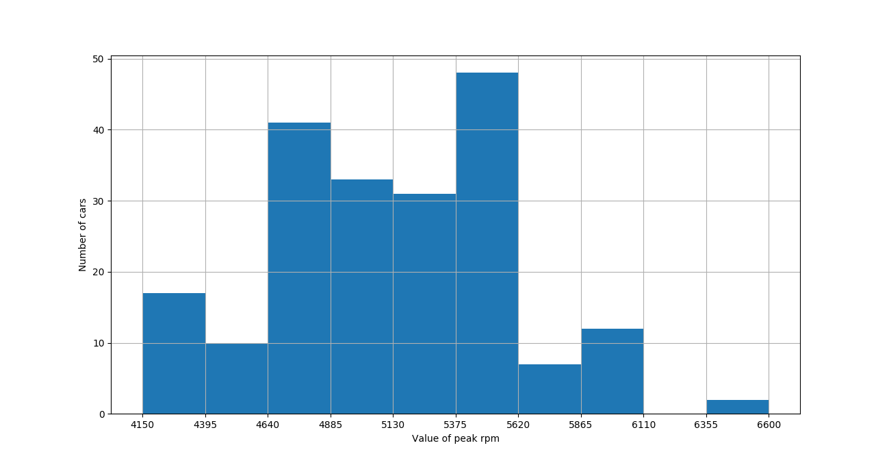
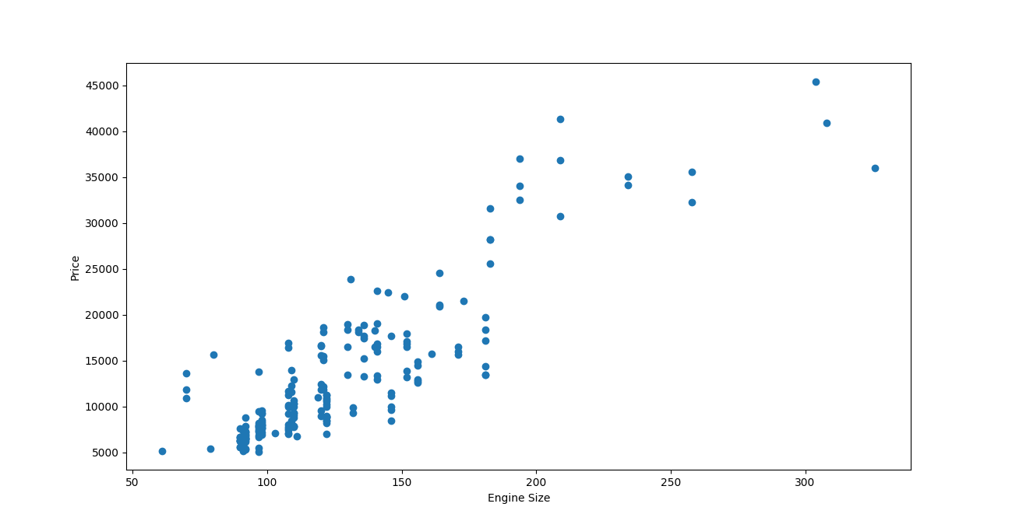
Plots for Descriptive statistics
Histogram
Scatter plot

Slide 30
Other methods for EDA
Grouping of data: The groupby() method from Pandas library helps us to accomplish this task.
Handling missing values:
When no data value is stored for a feature in a particular observation, we say this feature has missing values.
Examining this is important because when some of your data is missing, it can lead to weak or biased analysis.
We can detect missing values by applying isnull() method over the dataframe.
The isnull() method returns a rectangular grid of boolean values which tells us if a particular cell in the dataframe has missing value or not.

Slide 31
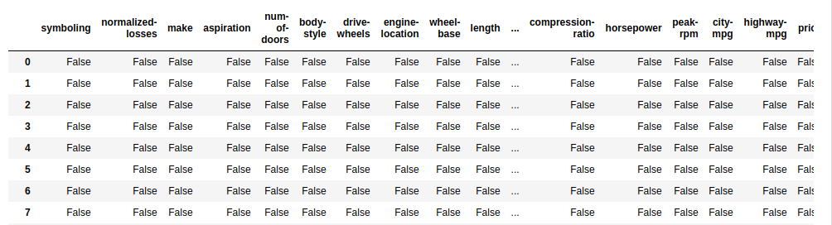
Handling Missing values
As you can see, analysing a grid of this style to detect missing value is not very convenient, so we will use heatmaps to visually detect these missing values.

Slide 32
Using Heatmaps for Missing values
Heatmap takes a rectangular data grid as input and then assigns a color intensity to each data cell based on the data value of the cell.
This is a great way to get visual clues about the data.
We will generate a heatmap of the output of isnull() in order to detect missing values.
Example: sns.heatmap(df.isnull())
plt.show()

Slide 33
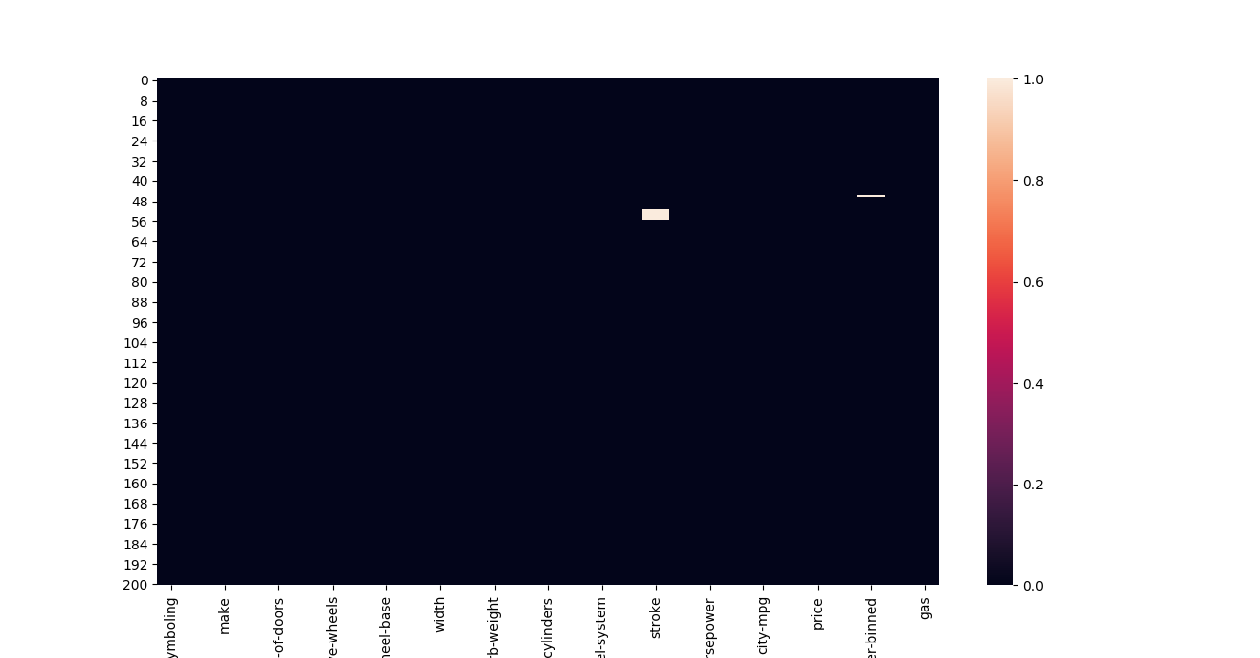
Using Heatmaps for Missing values
This indicates that “stroke” and “horsepower-binned” columns have few missing values.

Slide 34
Handling Missing values
We can handle missing values in many ways:
Delete: You can delete the rows with the missing values or delete the whole column which has missing values. The dropna() method from Pandas library can be used to accomplish this task.
Impute: Deleting data might cause huge amount of information loss. So, replacing data might be a better option than deleting. One standard replacement technique is to replace missing values with the average value of the entire column. For example, we can replace the missing values in “stroke” column with the mean value of stroke column. The fillna() method from Pandas library can be used to accomplish this task.
Predictive filling: Alternatively, you can choose to fill missing values through predictive filling. The interpolate() method will perform a linear interpolation in order to “guess” the missing values and fill the results in the dataset.

Slide 35
ANOVA (Analisi della Varianza)
L'ANOVA è un metodo statistico che è usato per scoprire le relazioni tra gruppi differenti di dati categorici.
Il test dell'ANOVA, ci fornisce due misure come risultato:
L'F-test score: che calcola la variazione tra medie di Gruppo del campione divise per la variazione all'interno del gruppo.
P value: Ci mostra l'intervallo di confidenza. In altre parole, ci dice se il risultato ottenuto è statisticamente significativo oppure no.
Il test dell'ANOVA può essere eseguito usando il metodo f_oneway() della libreria Scipy.

Slide 36
Correlation
Correlation is a statistical metric for measuring to what extent different variables are interdependent.
In other words, when we look at two variables over time, if one variable changes, how does this effect change in the other variable?
For example, smoking is known to be correlated with lung cancer. Since, smoking increases the chances of lung cancer. Another example would be the relationship between the number of hours a student studies and the score obtained by that student. Because, we expect the student who studies more to obtain higher marks in the exam.
We can see the correlation between different variables using the corr() function.
Then we can plot a heatmap over this output to visualize the results.
Example: correlation_matrix = df.corr()
sns.heatmap(correlation_matrix, annot=True)
plt.show()

Slide 37
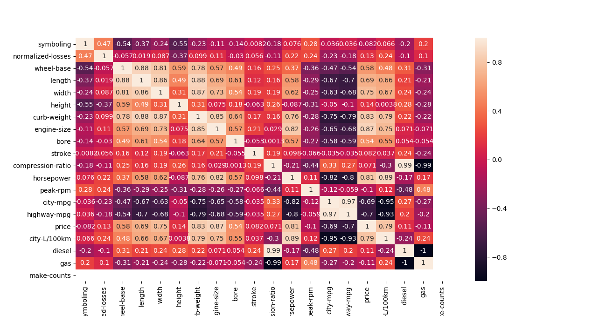
Heatmap for Correlation
From the above heatmap, we can see that engine size and price are positively correlated(score of 0.87) with each other while, highway-mpg and price are negatively correlated(score of -0.7) with each other. In other words, it tells us that cars with larger engine sizes will be costlier than cars with small engine sizes. It also tells us that expensive cars generally have less MPG as compared to cheaper cars.

Slide 38
References:
https://medium.com/analytics-vidhya/introduction-to-data-wrangling-88c1b5e747cb - Data wrangling
https://medium.com/code-heroku/introduction-to-exploratory-data-analysis-eda-c0257f888676 – EDA
https://medium.com/@klopmp/etl-using-python-and-pandas-90804bc541ee - ETL
https://medium.com/analytics-vidhya/normalization-vs-standardization-8937f45b3e20 – Data preprocessing
https://towardsdatascience.com/data-types-in-statistics-347e152e8bee – Data types
https://subscription.packtpub.com/book/data/9781838552862/1/ch01lvl1sec07/data-transformation – Encoding categorical data
https://medium.com/cracking-the-data-science-interview/an-introduction-to-big-data-data-integration-40715baa7961 – Data integration

Slide 39
Thanks for your attention

